Slide 1








Coin Changing
Goal. Given currency denominations: 1, 5, 10, 25, 100, devise a method to pay amount to customer using fewest number of coins.
Ex: 34¢.
Cashier's algorithm. At each iteration, add coin of the largest value that does not take us past the amount to be paid.
Ex: $2.89.

Slide 2
Coin-Changing: Greedy Algorithm
Cashier's algorithm. At each iteration, add coin of the largest value that does not take us past the amount to be paid.
Sort coins denominations by value: c₁ < c₂ < … < c_{n}.
coins selected
S ← φ
while (x ≠ 0) {
let k be largest integer such that c_{k} ≤ x if (k = 0)
return "no solution found"
x ← x - c_{k} S ← S ∪ {k}
}
return S
Q. Is cashier's algorithm optimal?

Slide 3


Coin-Changing: Analysis of Greedy Algorithm
Theorem. Greedy algorithm is optimal for U.S. coinage: 1, 5, 10, 25, 100. Pf. (by induction on x)
Consider optimal way to change c_{k} ≤ x < c_{k+1} : greedy takes coin k.
We claim that any optimal solution must also take coin k.
if not, it needs enough coins of type c₁, …, c_{k-1} to add up to x
table below indicates no optimal solution can do this
Problem reduces to coin-changing x - c_{k} cents, which, by induction, is optimally solved by greedy algorithm. ▪
k | _{ck} All optimal solutions Max value of coins must satisfy 1, 2, …, k-1 in any OPT
1 | 1 | P ≤ 4 | -
2 | 5 | N ≤ 1 | 4
3 | 10 | N + D ≤ 2 | 4 + 5 = 9
4 | 25 | Q ≤ 3 | 20 + 4 = 24
5 | 100 | no limit | 75 + 24 = 99

Slide 4

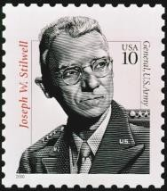
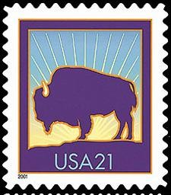
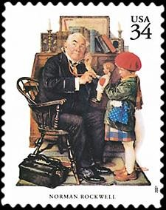
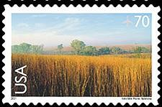

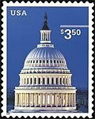
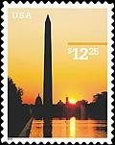
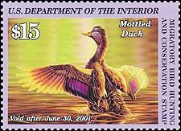
Coin-Changing: Analysis of Greedy Algorithm
Observation. Greedy algorithm is sub-optimal for US postal denominations: 1, 10, 21, 34, 70, 100, 350, 1225, 1500.
Counterexample. 140¢.
Greedy: 100, 34, 1, 1, 1, 1, 1, 1.
Optimal: 70, 70.

